Slide 1
Chapter 2
Processes and Threads
Tanenbaum, Modern Operating Systems 3 e, (c) 2008 Prentice-Hall, Inc. All rights reserved. 0-13-6006639

Slide 2
What is a process?
When the system is booted, many processes are secretly started, often unknown to the user. For example, a process may be started up to wait for incoming email. Another process may run on behalf of the antivirus program to check periodically if any new virus definitions are available. In addition, explicit user processes may be running, printing files and backing up the user’s photos on a USB stick, all while the user is surfing the Web. All this activity has to be managed, and a multiprogramming system supporting multiple processes comes in very handy here.

Slide 3
What is a process?
An instance of a program, including the current values of the program counter, registers, and variables
It has a program, input, output and a state
Why is this idea necessary?
  In any multiprogramming system, the CPU switches from process to process quickly, running each for tens or hundreds of milliseconds. While, strictly speaking, at any one instant the CPU is running only one process, Keeping track of multiple, parallel activities is hard for people to do. Therefore, operating system designers over the years have evolved a conceptual model (sequential processes) that makes parallelism easier to
  deal with.
Tanenbaum, Modern Operating Systems 3 e, (c) 2008 Prentice-Hall, Inc. All rights reserved. 0-13-6006639

Slide 4

Multiprogramming
Figure. 1 (a) Multiprogramming of four programs. (b) Conceptual model of four independent, sequential processes. (c) Only one program is active at once.
Tanenbaum, Modern Operating Systems 3 e, (c) 2008 Prentice-Hall, Inc. All rights reserved. 0-13-6006639

Slide 5
Multiprogramming
In Fig.1(a) we see a computer multiprogramming four programs in memory.
In Fig.1(b) we see four processes, each with its own flow of control (i.e., its own logical program counter), and each one running independently of the other ones. Of course, there is only one physical program counter, so when each process runs, its logical program counter is loaded into the real program counter. When it is finished (for the time being), the physical program counter is saved in the process’ stored logical program counter in memory.
In Fig.1(c) we see that, viewed over a long enough time interval, all the processes have made progress, but at any given instant only one process is actually running.

Slide 6
Process Creation
Events which can cause process creation
System initialization.
When an operating system is booted, typically numerous processes are created. Some of these are foreground processes, that is, processes that interact with (human) users and perform work for them. Others run in the background and are not associated with particular users, but instead have some specific function.
Execution of a process creation system call by a running process.
A running process will issue system calls to create one or more new processes to help it do its job. For example, if a large amount of data is being fetched over a network for subsequent processing, it may be convenient to create one process to fetch the data and put them in a shared buffer while a second process removes the data items and processes them.
A user request to create a new process.
In interactive systems, users can start a program by clicking on an icon. Taking this action starts a new process and runs the selected program in it.
Initiation of a batch job.
In this situation where processes are created applies only to the batch systems found on large mainframes.
Tanenbaum, Modern Operating Systems 3 e, (c) 2008 Prentice-Hall, Inc. All rights reserved. 0-13-6006639

Slide 7
Process Termination
Events which cause process termination:
Normal exit (voluntary).
Most processes terminate because they have done their work.
Error exit (voluntary).
The process discovers a fatal error. For example, if a user types the command
cc foo.c
to compile the program foo.c and no such file exists, the compiler simply announces this fact and exits.
Fatal error (involuntary).
Due to an error caused by the process, often due to a program bug. Examples include executing an illegal instruction, referencing nonexistent memory, or dividing by zero.
Killed by another process (involuntary).
A process executes a system call telling the operating system to kill some other process. In UNIX this call is kill. The corresponding Win32 function is TerminateProcess.
Tanenbaum, Modern Operating Systems 3 e, (c) 2008 Prentice-Hall, Inc. All rights reserved. 0-13-6006639

Slide 8
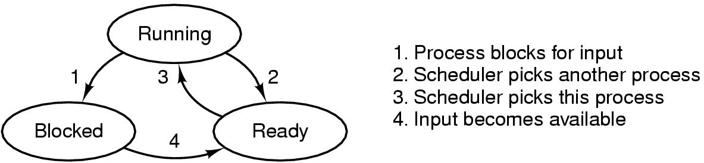
Process States
The three states a process may be in:
1. Running (actually using the CPU at that instant).
2. Ready (runnable; temporarily stopped to let another process run).
3. Blocked (unable to run until some external event happens).
A process can be in running, blocked, or ready state. Transitions between these states are as shown.
Tanenbaum, Modern Operating Systems 3 e, (c) 2008 Prentice-Hall, Inc. All rights reserved. 0-13-6006639

Slide 9
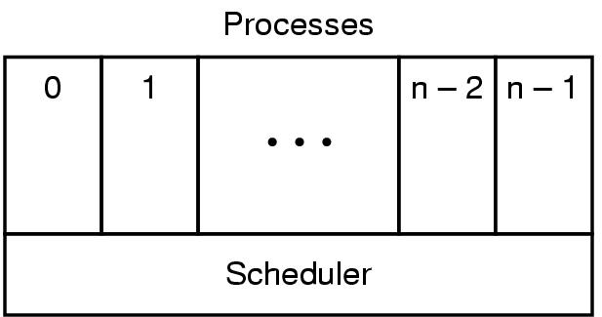
Implementation of Processes (1)
The lowest level of the operating system is the scheduler, with a variety of processes on top of it. All the interrupt handling and details of actually starting and stopping processes are hidden away in the scheduler. The rest of the operating system is nicely structured in process form.
Tanenbaum, Modern Operating Systems 3 e, (c) 2008 Prentice-Hall, Inc. All rights reserved. 0-13-6006639

Slide 10
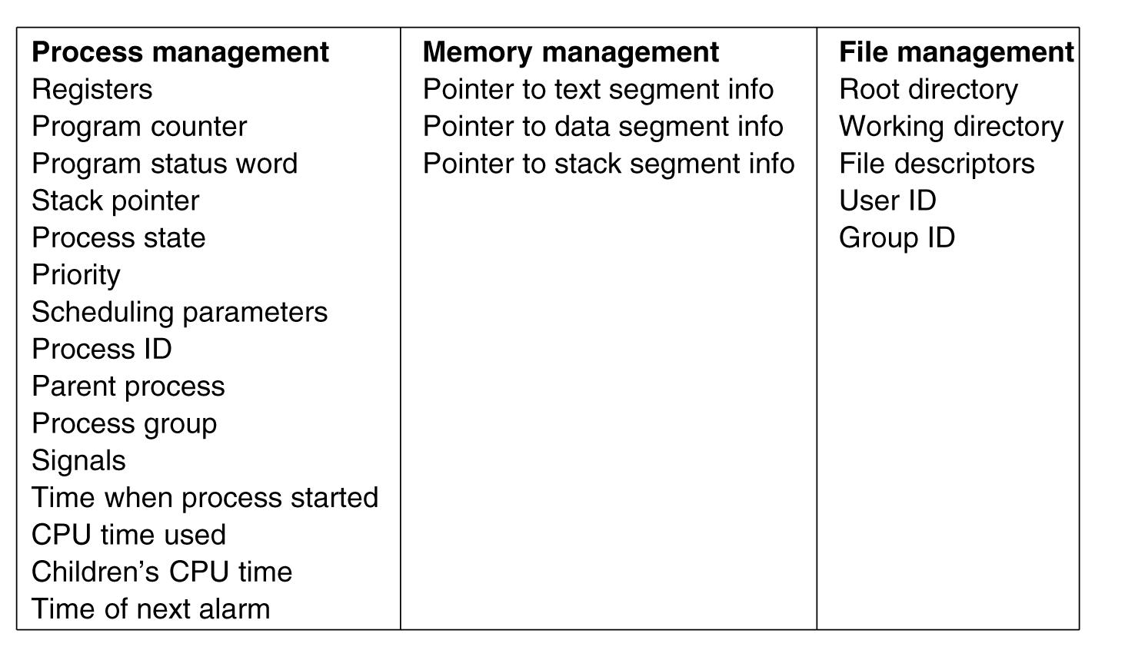
Implementation of Processes (2)
Some of the fields of a typical process table entry.
To implement the process model, the operating system maintains a table called the process table, with one entry per process. This entry contains important information about the process’ state, including its program counter, stack pointer, memory allocation, the status of its open files, its accounting and scheduling information, and everything else about the process that must be saved when the process is switched from running to ready or blocked state so that it can be restarted later.
Tanenbaum, Modern Operating Systems 3 e, (c) 2008 Prentice-Hall, Inc. All rights reserved. 0-13-6006639

Slide 11
Who cares about scheduling algorithms?
Batch servers
Networked servers
You care if you have a bunch of users and/or if the demands of the jobs differ
Tanenbaum, Modern Operating Systems 3 e, (c) 2008 Prentice-Hall, Inc. All rights reserved. 0-13-6006639

Slide 12
Who doesn’t care about scheduling algorithms?
PC’s
  One user who only competes with himself for the CPU
Tanenbaum, Modern Operating Systems 3 e, (c) 2008 Prentice-Hall, Inc. All rights reserved. 0-13-6006639

Slide 13

Scheduling – Process Behavior
Figure. 2 Bursts of CPU usage alternate with periods of waiting for I/O. (a) A CPU-bound process. (b) An I/O-bound process.
Tanenbaum, Modern Operating Systems 3 e, (c) 2008 Prentice-Hall, Inc. All rights reserved. 0-13-6006639

Slide 14
Often, the CPU runs for a while without stopping, then a system call is made to read from a file or write to a file. When the system call completes, the CPU computes again until it needs more data or has to write more data, and so on. The important thing to notice about Fig. 2 is that some processes, such as the one in Fig. 2(a), spend most of their time computing, while other processes, such as the one shown in Fig. 2(b), spend most of their time waiting for I/O.
The former are called compute-bound or CPU-bound; the latter are called I/Obound.
The basic idea here is that if an I/O-bound process wants to run, it should get a chance quickly so that it can issue its disk request and keep the disk busy.

Slide 15
A nonpreemptive scheduling algorithm picks a process to run and then just lets it run until it blocks (either on I/O or waiting for another process) or voluntarily releases the CPU.
A preemptive scheduling algorithm picks a process and lets it run for a maximum of some fixed time.

Slide 16
When to make scheduling decisions
New process creation
Schedule when
  A process exits
  A process blocks
  I/O interrupt happens
Tanenbaum, Modern Operating Systems 3 e, (c) 2008 Prentice-Hall, Inc. All rights reserved. 0-13-6006639

Slide 17
Categories of Scheduling Algorithms
Batch (accounts receivable, payroll…..)
Interactive (Servers,…)
Real time (processes usually do their work and block quickly ex: Airlines reservation system, Heart Pacemaker, Network Multimedia Systems, Robot etc.)
Tanenbaum, Modern Operating Systems 3 e, (c) 2008 Prentice-Hall, Inc. All rights reserved. 0-13-6006639

Slide 18
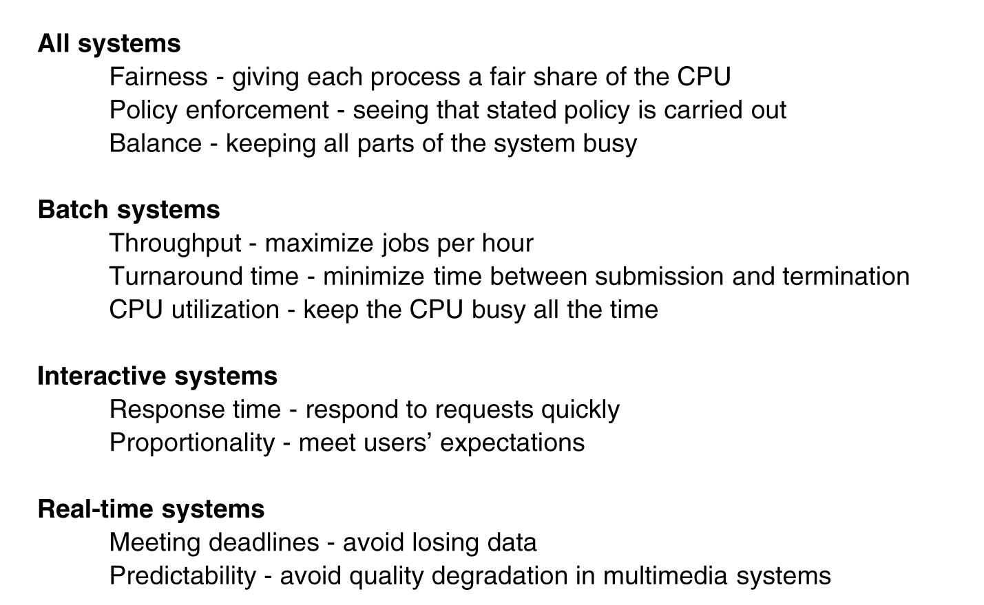
Scheduling Algorithm Goals
Tanenbaum, Modern Operating Systems 3 e, (c) 2008 Prentice-Hall, Inc. All rights reserved. 0-13-6006639

Slide 19
Scheduling in Batch Systems
First-come first-served
Shortest job first
Shortest remaining time next
Tanenbaum, Modern Operating Systems 3 e, (c) 2008 Prentice-Hall, Inc. All rights reserved. 0-13-6006639

Slide 20
First-come, First-served
With this algorithm, processes are assigned the CPU in the order they request it. When the first job enters the system from the outside in the morning, it is started immediately and allowed to run as long as it wants to. It is not interrupted because it has run too long. As other jobs come in, they are put onto the end of the queue.
Easy to implement
Won’t work for a varied workload
  I/O bound processes (long execution time) runs in front of compute-bound process (short execution time)
Tanenbaum, Modern Operating Systems 3 e, (c) 2008 Prentice-Hall, Inc. All rights reserved. 0-13-6006639

Slide 21
Shortest Job First
Need to know run times in advance
NonPreemptive
Provably optimal
Ex: 4 jobs with runs times of a,b,c,d
First finishes at a, second at a+b,third at a+b+c, last at a+b+c+d
Mean turnaround time is (4a+3b+2c+d)/4
=> smallest time has to come first to minimize the mean turnaround time
Shortest job first is optimal only when all the jobs are available simultaneously.
Tanenbaum, Modern Operating Systems 3 e, (c) 2008 Prentice-Hall, Inc. All rights reserved. 0-13-6006639

Slide 22
Shortest Remaining Time Next
Pick job with shortest time to execute next
Preemptive: compare running time of new job to remaining time of existing job
Need to know the run times of jobs in advance
When a new job arrives, its total time is compared to the current process’ remaining time. If the new job needs less time to finish than the current process, the current process is suspended and the new job started. This scheme allows new short jobs to get good service.
Tanenbaum, Modern Operating Systems 3 e, (c) 2008 Prentice-Hall, Inc. All rights reserved. 0-13-6006639

Slide 23
Scheduling in Interactive Systems
Round robin
Priority
Multiple Queues
Shortest Process Next
Guaranteed Scheduling
Lottery Scheduling
Fair Share Scheduling
Tanenbaum, Modern Operating Systems 3 e, (c) 2008 Prentice-Hall, Inc. All rights reserved. 0-13-6006639

Slide 24
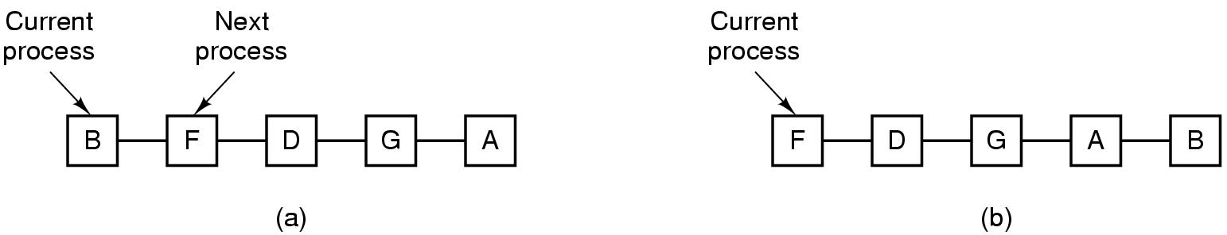
Round-Robin Scheduling
One of the oldest, simplest, fairest, and most widely used algorithms is round robin. Each process is assigned a time interval, called its quantum, during which it is allowed to run. If the process is still running at the end of the quantum, the CPU is preempted and given to another process. If the process has blocked or finished before the quantum has elapsed, the CPU switching is done when the process blocks, of course.
Round robin is easy to implement.
Process list-before and after
Tanenbaum, Modern Operating Systems 3 e, (c) 2008 Prentice-Hall, Inc. All rights reserved. 0-13-6006639

Slide 25
Round robin
If Quantum is too short => too many process switches and lowers the CPU efficiency
If Quantum is too long => wasted processes’ time, poor response to short interactive requests
Don’t need to know run times in advance
Tanenbaum, Modern Operating Systems 3 e, (c) 2008 Prentice-Hall, Inc. All rights reserved. 0-13-6006639

Slide 26
Priority Scheduling
Runs jobs according to their priority
Each process is assigned a priority, and the runnable process with the highest priority is allowed to run.
Can be static or can do it dynamically
Static: On a military computer, processes started by generals might begin at priority 100, processes started by colonels at 90, majors at 80 and so on.
Dynamic: A process that used only 1 msec of its 50-msec quantum would get priority 50, while a process that ran 25 msec before blocking would get priority 2, and a process that used the whole quantum would get priority 1.
Typically combines Round Robin (RR) with priority. Each priority class uses RR inside
Tanenbaum, Modern Operating Systems 3 e, (c) 2008 Prentice-Hall, Inc. All rights reserved. 0-13-6006639

Slide 27
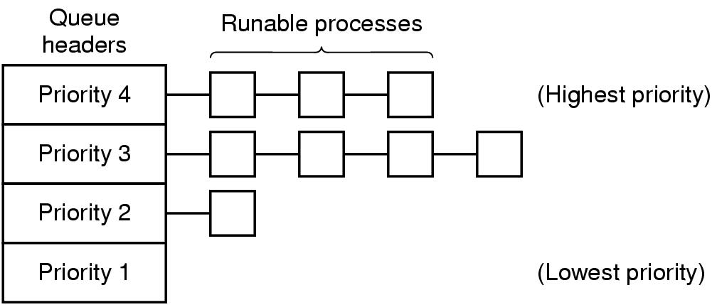
Priority Scheduling
Tanenbaum, Modern Operating Systems 3 e, (c) 2008 Prentice-Hall, Inc. All rights reserved. 0-13-6006639

Slide 28
Multiple Queues with Priority Scheduling
Highest priority gets one quantum, second highest gets 2…..
  If highest finishes during quantum, great. Otherwise bump it to second highest priority and so on into the night
Consequently, shortest (high priority) jobs get out of town first
No previous knowledge assumed!
Tanenbaum, Modern Operating Systems 3 e, (c) 2008 Prentice-Hall, Inc. All rights reserved. 0-13-6006639

Slide 29
Shortest Process Next
Because shortest job first always produces the minimum average response time for batch systems, it would be nice if it could be used for interactive processes as well.
Cool idea if you know the remaining times
Exponential smoothing can be used to estimate a jobs’ run time One approach is to make estimates based on past behavior and run the process with the shortest estimated running time. Suppose that the estimated time per command for some process is T0. Now suppose its next run is measured to be T1. We could update our estimate by taking a weighted sum of these two numbers,
aT0 + (1-a)T1 where T0 and T1 are successive runs of the same job
This is called aging
Tanenbaum, Modern Operating Systems 3 e, (c) 2008 Prentice-Hall, Inc. All rights reserved. 0-13-6006639

Slide 30
Lottery Scheduling
The basic idea is to give processes lottery tickets for various system resources, such as CPU time. Whenever a scheduling decision has to be made, a lottery ticket is chosen at random, and the process holding that ticket gets the resource. When applied to CPU scheduling, the system might hold a lottery 50 times a second, with each winner getting 20 msec of CPU time as a prize.
Can enforce priorities by allowing more tickets for “more important” processes
Tanenbaum, Modern Operating Systems 3 e, (c) 2008 Prentice-Hall, Inc. All rights reserved. 0-13-6006639

Slide 31
Real Time Scheduling
Hard real time vs soft real time
  Hard: meaning there are absolute deadlines that must be met ex: robot control in a factory
  Soft: meaning that missing an occasional deadline is undesirable, but nevertheless tolerable ex: CD player
Events can be periodic (meaning they occur at regular intervals) or aperiodic (meaning they occur unpredictably)
Algorithms can be static (make decisions before runtime) or dynamic (run time decisions)
Tanenbaum, Modern Operating Systems 3 e, (c) 2008 Prentice-Hall, Inc. All rights reserved. 0-13-6006639

